Slide 1
Customer Analytics - Predicting Customer Churn

Slide 2
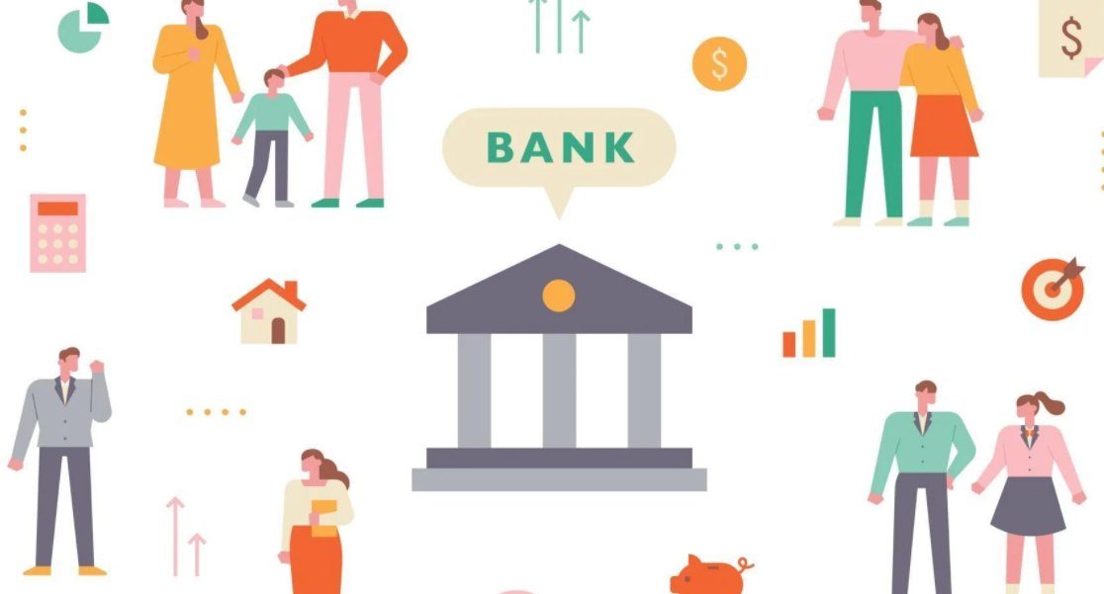
Customer Analytics – Reshaping the Banking Industry
For banking and financial service providers to succeed in today’s business environment, it’s important and necessary to understand the needs and expectations of their customer base
Both the internal and external data sources associated with the banking and financial industry can be of great importance in customer communication
Leveraging customer analytics solutions can help banking industry analyse customer behaviour and develop suitable offerings to meet their needs
Notes:
Image Link: https://www.vecteezy.com/vector-art/2126283-bank-system-banner-with-icons-and-customers
Notes:
For banking and financial service providers to succeed in today’s complex business scenario, it’s important and necessary to understand the needs and expectations of their customer base. Both the internal and external data sources associated with the banking and financial industry can be of great importance in product development and customer communication. This data can be further analyzed by leveraging customer analytics solutions to understand the customer expectation and need at a granular level. Banking industry players must have a strong customer segmentation policy to develop new product offerings to meet customer expectations.

Slide 3

Customer Analytics – Applications
Offer in-depth insights on customer behaviour and customer requirements. For example, behavioural insights are gaining importance as the preference of product usage has now become more differentiated
Providing personalized interactions that assists customers with their daily financial needs to enhance customer experience
Insights that provide transaction patterns and social media interactions which is mostly used in curtailing risks and fraud management
To design the marketing communication and devise effective marketing strategies and improve sales
Notes:
Image Link: https://www.vecteezy.com/vector-art/2007128-data-analysis-and-statistics-concept-business-analytics-data-visualization-technology-isometric-investors-and-creative-providers-sit-and-discuss-providing-customer-flat-vector-illustration
Notes:
How can customer analytics help banking services?
1: Offers in-depth customer insights
Most of the banking and financial services providers are keen to gain granular insights on current and upcoming requirements of their customers. However behavioral insights are gaining importance as the preference of product usage has now become more differentiated.
2: Managing customer experience
Using customer analytics for managing customer experience, helps banking and financial services providers in delivering personalized, interactions that assists customers with their daily financial needs. Moreover, customer analytics enables the real-time delivery of product or service offerings at the right time, which enhances the customer experience.
3: Managing risks in banking and financial sector
Customer analytics in the banking sector is mostly used in curtailing risks and fraud management. The applications of customer analytics have expanded beyond providing purchase insights. It can also help in providing details on transaction patterns and even social media interactions. The integration of structured and unstructured data in banking services can also be leveraged for traditional risk management including pricing decisions.
4: Enhances marketing efforts
From the very beginning customer analytics in banking and financial sector has been used in devising marketing strategies. The potential of customer analytics to draw customer insights helps organizations to design their marketing communication. Banking and financial services providers now can make unique offers based on available customer data. This helps banking services providers to improve the efficiency of marketing spending and improve sales.

Slide 4

Influence of Customer Analytics
Integrating customer analytics in their business strategies, banks and other financial institutions can segment customers effectively, consider a more customer-oriented approach, enable better management and measurement of sales leads across channels, contemplate the inclusion of custom customer incentives or rewards to influence their behaviors, and more
Notes:
Image Link: https://www.vecteezy.com/vector-art/1434714-digital-marketing-set-with-people-in-various-scenes

Slide 5
Influence of Customer Analytics
Customer analytics will not only help banks predict customer behaviour but also assist in acquiring and retaining them
However, developing and implementing an effective customer acquisition strategy requires banking services to have data analytical experiences
They will also require to have marketing and measurement capabilities that will help them acquire customers, automate processing and decision making, manage customer accounts, and minimize customer acquisition costs and risks
Notes:
Image Link:

Slide 6

Predicting Customer Churn
The key to extracting meaningful predictive insights is in defining what is considered as a “churn event”
In general, churn is expressed as a degree of customer inactivity or disengagement, observed over a given time. This manifests within the data in various forms such as the recency of account actions or change in the account balance
In the case of High Net-Worth customers, it is useful to define churn based on the rate of decline of assets over a specified period. There could be an instance where a customer may be highly active in terms of account operations but has effectively pulled out more than 50% of her assets in the last six months
Notes:
Image Link: https://www.pointillist.com/blog/reduce-churn-customer-journey-analytics/
Notes:
Defining Churn: The key to extracting meaningful predictive insights is in defining the problem statement building blocks as accurately as possible. In the case of customer churn, it starts with defining what is considered as a “churn event”.
In general, churn is expressed as a degree of customer inactivity or disengagement, observed over a given time. This manifests within the data in various forms such as the recency of account actions or change in the account balance. For example, in the case of HNW (High Net-Worth) customers, it is useful to define churn based on the rate of decline of assets over a specified period. There could be an instance where a customer may be highly active in terms of account operations but has effectively pulled out more than 50% of her assets in the last six months.
Another aspect of the business problem is how early do you want the model to predict? A prediction that is too far out may be less accurate. On the other hand, a short prediction horizon may fare better in accuracy, but it could be too late to intervene once the customer has already made her mind up.
Finally, it is crucial to determine if churn has to be defined at a product level (customer likely to disengage with a particular product, like discontinuing a credit card) or at the relationship level (customer likely to disengage with the bank itself). When the data is analyzed at a relationship level, you get a better understanding of the customer’s point of view. For example, excessive withdrawal from one’s savings account could be a down payment for a house or funding for college tuition. Such insights into customer life events are very powerful not only to prevent churn but also to cross-sell complementing products which can further strengthen the relationship.

Slide 7

Predicting Customer Churn
Customer data:
One of the first things to work on is to capture and represent all key aspects of a customer’s relationship with the bank. Building a complete Customer dataset is the foundation for not just churn prediction, but also for other use cases such as cross-sell/upsell recommendation, customer lifetime value calculation, etc.
Notes:
Image Link: https://www.vecteezy.com/vector-art/1879468-search-and-find-store-location-looking-for-store-with-data-security-protection-promote-to-get-customers-flat-vector-illustration-for-landing-page-web-website-banner-mobile-apps-flyer-poster
Notes:
Building a Customer 360 view: One of the first milestones in using machine learning and advanced analytics to predict a churn event is to capture and represent all key aspects of a customer’s relationship with the bank. Building this Customer 360 data mart in a scalable, phased manner is the foundation for not just churn prediction, but also for other use cases such as cross-sell/upsell recommendation, customer lifetime value calculation, etc. In addition to customer demographics and profile indicators, other major subject areas in the data mart can include transactions on current and savings accounts, investment activities, product ownership (line of credit, insurance, and cards), channel-wise activity, campaign response, and customer service interactions. All these help in bringing various aspects of customer touchpoints and activities into a single snapshot.

Slide 8
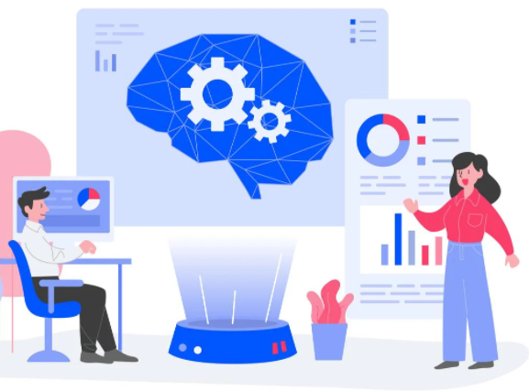
Predicting Customer Churn
Feature Engineering:
It plays a pivotal role in defining and creating data elements that capture customer behavior. It is imperative to actively involve the business stakeholders in this stage to identify potentially useful indicators that drive churn based on their collective experience.
Notes:
Image Link: https://www.vecteezy.com/vector-art/457268-deep-learning-illustration-concept-modern-flat-design-concept-of-web-page-design-for-website-and-mobile-website-vector-illustration
Notes:
Feature Engineering: Feature engineering is the process of using domain knowledge of the data to create features that make machine learning algorithms work. It plays a pivotal role in defining and creating data elements that capture customer behavior. For example, two accounts with the same monthly closing balance can be hard to tell apart. However, feature engineering can add a stochastic process (time dimension) to the same data so that algorithms can distinguish whether the monthly closing balance amount is a deviation from what is usually expected from the customer. Basic indicators like net balance outflow in the last few months, to more nuanced indicators like rate of change of average gap between bill payments made, can prove effective in providing early warning signals of impending churn. It is imperative to actively involve the business stakeholders in this stage to identify potentially useful indicators based on their collective experience. Features can represent “symptoms” of churn, like increasing withdrawals or dormant accounts, or, can represent the “drivers” of churns itself – such as difficult online experience, poor customer service or heavy fees on ATM withdrawals. Creative ways of mining insights from textual feedback (sentiment analysis) such as conversation notes from customer service, a bad experience with a poorly performing relationship manager, and interaction at various online and offline customer touchpoints create new features that are very effective in capturing intent to churn. Similarly, external data such as competitor offers, localized macroeconomic indicators, when combined with internal data provide powerful insights into customer behavior.

Slide 9

Predicting Customer Churn
Machine Learning models:
Churn prediction falls under the classification problem category – which means models like Logistic Regression, Tree-based models, ensemble models, etc., can help predict churn rate. Apart from providing the business teams with a regularly updated churn score for each customer, it is highly advisable to list the top predictors (cause) and their relative influence (effect) for each customer.
Notes:
Image Link: https://www.nature.com/articles/s41591-020-01197-2?utm_source=other&utm_medium=other&utm_content=null&utm_campaign=JRCN_1_DD01_CN_NatureRJ_article_paid_XMOL
Notes:
Machine Learning models: Churn prediction falls under the typical classification problem category. From the tried and tested logistic regression techniques to complex tree-based techniques like XG Boost, the key is to identify the technique that offers the right balance of interpretability and performance. While complex algorithms like random forest and XGBoost capture non-linear patterns in data and handle null values (which can be quite common!) quite comfortably, logistic regression offers a more transparent and intuitive explanation of the impact of each variable on the predicted outcome. It is always advisable to validate the model on at least two to three time periods outside its training dataset and check for consistency in predictions across seasons.
Apart from providing the business teams with a regularly updated churn score for each customer, it is highly advisable to list the top predictors (cause) and their relative influence (effect) for each customer. This helps in driving the right conversations at the time of intervention.

Slide 10

Predicting Customer Churn
Business Adoption:
Business adoption starts with effectively demonstrating the model’s predictive power for a recent historical period and running several simulations to measure the effectiveness of the model and associated strategy.
The next step is designing an effective campaign to put the model to test. Typical questions like – How many of your “at-risk” customers do I contact? How do I further prioritize my contact strategy? What treatment or interventions do I offer? How do I measure the impact of the model post-campaign? – can help define a “priority” customer
Notes:
Image Link: https://www.vecteezy.com/vector-art/2106213-online-customers-survey-concept
Notes:
Business Adoption: Driving Business Adoption
Driving business adoption is one of the most challenging activities and requires orchestrated effort from all the stakeholders involved. It starts with effectively demonstrating the model’s predictive power for a recent historical period and running several simulations to measure the effectiveness of the model and associated strategy. Claims such as ‘the model captures 70% of potential churners at least six months prior to the event’ – are sure to generate interest. Also, an articulation of business value such as “the model can save an additional $20 million of balance outflow every month” demonstrate tangible impact.
The next milestone is designing an effective campaign to put the model to test. Typical questions to be expected are – How many of your “at-risk” customers do I contact? How do I further prioritize my contact strategy? What treatment or interventions do I offer? How do I measure the impact of the model post-campaign? All of these questions can be answered by understanding the CRM team’s current efforts to mitigate churn, the resources they have to run the campaign, and the marketing and business teams’ definition of a ‘priority’ customer.
Test vs. Control approach is one of the standard approaches where you can select similar groups of customers among the different categories of likely to churn. Of which, the test group receives the model-based interventions and the control group does not. The next step is to observe the churn rates in both groups in the post-campaign period and use the churn rate in the control group as a baseline to highlight the incremental effect in the test group (in this case, an x% reduction in churn rate).
To summarize, all banks acknowledge customer churn as a significant business problem, but often lack a systematic and proactive way to address it. Even after harnessing the power of massive data and building robust churn prediction models, the challenge lies in creating an ecosystem of enablers at every stage. It encompasses setting the data pipeline to generate, store, and report churn likelihood scores. And then collaborating with business, marketing, CRM and the concerned relationship managers and branch colleagues, who will benefit from the insights during their conversations to offer right retention strategies.

Slide 11
Python Case Study – Customer Churn Prediction
Objective:
Predict the customer churn rate of a bank for effective customer understanding and behavioural analysis
Dataset:
https://www.kaggle.com/mathchi/churn-for-bank-customers
A publicly available dataset containing information on customer demographics and their financial background, and whether they exited from the bank or not.

Slide 12
Python Case Study – Customer Churn Prediction
Data Preprocessing:
EDA – exploratory analysis of features and target variable using pie charts, count plots and boxplots
Feature scaling – scaling numerical features to reduce skewness
Create dummies – binary columns to indicate the presence and absence of a specific information, encoded as ‘1’ and ‘0’ respectively
Oversampling – increasing the samples of minority class from the existing ones to overcome class imbalance issues

Slide 13
Python Case Study – Customer Churn Prediction
Machine Learning algorithms:
Split the data into training data (to fit the model) and test data (to validate the model)
Since we are predicting the customer churn– the likelihood of a customer leaving the bank – this is a Classification problem, specifically a Binary Classification problem as it has two levels – a ‘YES’ and a ‘NO’
We fit the training data to a GLM model in order to understand feature significance in detail, i.e., the features that drive churn prediction
We also fit the following models with the training data – Logistic Regression, Decision Tree Classifier, Random Forest Classifier, Gradient Boost and Adaptive Boost in order to select the best model out of the lot

Slide 14
Random Forest Classifier
Random forest is a supervised learning algorithm
The "forest" it builds, is an ensemble of decision trees, usually trained with the “bagging” method. The general idea of the bagging method is that a combination of learning models increases the overall result
Random forest adds additional randomness to the model, while growing the trees. Instead of searching for the most important feature while splitting a node, it searches for the best feature among a random subset of features
This results in a wide diversity that generally results in a better model
Random forest prevents Overfitting by creating random subsets of the features and building smaller trees using those subsets

Slide 15
AdaBoost Classifier
Boosting is an ensemble technique that attempts to create a strong classifier from a number of weak classifiers
This is done by building a model from the training data, then creating a second model that attempts to correct the errors from the first model.
Models are added until the training set is predicted perfectly or a maximum number of models are added
AdaBoost is best used to boost the performance of decision trees on binary classification problems
AdaBoost was designed in such a way that at every step the sample distribution was adapted to put more weight on misclassified samples and less weight on correctly classified samples. The final prediction is a weighted average of all the weak learners, where more weight is placed on stronger learners

Slide 16
GradientBoosting Classifier
Gradient boosting algorithm builds first weak learner and calculates the Loss Function. It then builds a second learner to predict the loss after the first step. The step continues for third learner and then for fourth learner and so on until a certain threshold is reached
Gradient boosting increases the accuracy by minimizing the Loss Function (error which is difference of actual and predicted value) and having this loss as target for the next iteration
The main difference therefore is that Gradient Boosting is a generic algorithm to find approximate solutions to the additive modeling problem, while AdaBoost can be seen as a special case with a particular loss function (Exponential loss function). Hence, gradient boosting is much more flexible

Slide 17
Python Case Study – Customer Churn Prediction
Evaluation of models:
Evaluate model performance with the help of Confusion matrix, the classification report (which displays Precision, Recall and F1-Score), ROC-Score
Perform Hyperparameter tuning to optimize model performance and observe the best parameters that drives model performance
Compare all models and finalize on the model with the best metrics

Slide 18
Python Case Study – Customer Churn Prediction
Evaluation of models:
Accuracy Score isn’t the be-all, end-all of model performance, especially when dealing with imbalanced datasets
Precision, Recall and F1-score are used to understand model performance and can be tuned (based on the needed context) to optimize model performance
Determine feature importance score with the selected best performing model and visualize the same to analyse features pivotal in customer churn prediction

Slide 19
Python Case Study – Customer Churn Prediction
Evaluation of models:
Accuracy Score isn’t the be-all, end-all of model performance, especially when dealing with imbalanced datasets
Precision, Recall and F1-score are used to understand model performance and can be tuned (based on the needed context) to optimize model performance
Determine feature importance score with the selected best performing model and visualize the same to analyse features pivotal in customer churn prediction

Slide 20
Python Case Study – Customer Churn Prediction
Post-modelling analysis and business takeaways:
The main aim here is to observe the features that drive churn prediction in the model, i.e., what features are significant in insinuating whether a customer leaves or not
Majority of the data is from France. However, the proportion of churned customers is inversely related to the population of customers alluding to the bank possibly having a problem – maybe not enough customer service resources allocated – in the areas where it has fewer clients

Slide 21
Python Case Study – Customer Churn Prediction
On average, women are more likely to churn regardless of the region. This is attributable to the statistical fact that women are more conservative than men when it comes to risk and reward. They are more susceptible to change based on recommendations so the bank needs to emphasize on improving customer service and offer more attractive credit terms
Unsurprisingly, the inactive members have a greater churn. It's concerning that the overall proportion of inactive members is quite high, suggesting that the bank may need a program implemented to turn this group to active customers as this will definitely have a positive impact on the customer churn.

Slide 22
Python Case Study – Customer Churn Prediction
The older customers are churning more than the younger ones implying a difference in service preference among the age categories. The bank may need to review their target market or review the strategy for retention between the different age groups. They would have to sensitize marketing strategies to appeal to the older customers in order to retain them
Worryingly, the bank is losing customers with significant bank balances which is likely to hit their available capital for lending. Bank should focus on strengthening relationships with these set of customers by improving customer service aspects like KPIs, frequent communication, leveraging feedback, etc.,

Slide 23
Python Case Study – LIME
LIME: Local Interpretable Model-Agnostic Explanations
LIME is an actual method developed by researchers to gain greater transparency on what’s happening inside an algorithm.
The researchers explain that LIME can explain “the predictions of any classifier in an interpretable and faithful manner, by learning an interpretable model locally around the prediction.”
What this means: LIME model develops an approximation of the model by testing it out to see what happens when certain aspects within the model are changed. Essentially it’s about trying to recreate the output from the same input through a process of experimentation

Slide 24

Python Case Study – How to run LIME
Install LIME in ANACONDA – pip install LIME
Import the following packages:
Extract all the features from your data and place them in different lists based on their type (float in one list, int64 in another)
Concatenate the list of features into a single list (utilized by the LIME explainer)
Run the Best model (gdb_tuned) and obtain the prediction probabilities for the target variable (‘Exited’) (needed for the LIME explainer)

Slide 25
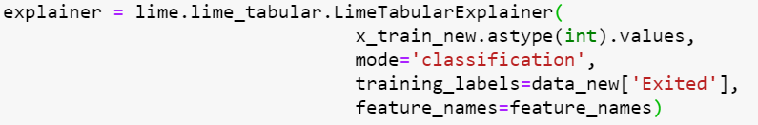
Python Case Study – How to run LIME
Create the LIME explainer:
xtrain – training set
mode – type of model
training_labels – target variable
feature_names – concatenated list of features

Slide 26
Python Case Study – How to run LIME
Obtain the explanation from LIME for particular values in the test set:
The explainer takes a particular observation from the test set for which the probability values of each class is calculated. LIME will provide an explanation for assigning the probability
Check the LIME for observations that predict both 0 and 1, in this case index 0 (output ‘0’) and index 3 (output ‘1’), and compare the probability value to the actual class of the target variable for the prediction

Slide 27
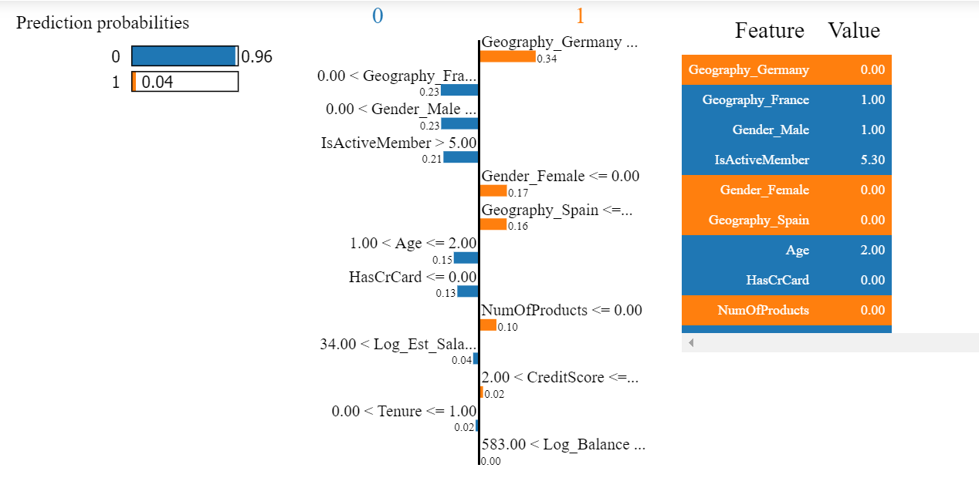
Python Case Study – How to run LIME
Explanations for row 1 in test data that support class 0:
Prediction probabilities for class 0 and class 1 for xtest[0]
Features and their relative importances.
Georgraphy_Germany is assigned an importance of 0.34 and the colour indicates if its contributing to 0 (blue) or 1 (orange)
The ranges (<=x=>) indicates if this feature’s value satisfies this criteria, it supports class 0 or 1
All features that support each class with their respective values

Slide 28
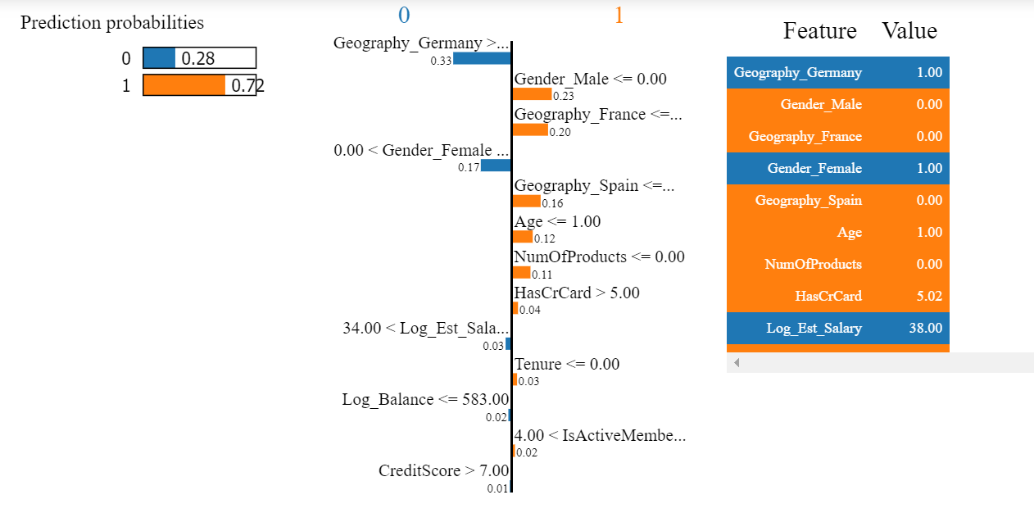
Python Case Study – How to run LIME
Explanations for row 4 in test data that support class 1:
Prediction probabilities for class 0 and class 1 for xtest[3]
Here, one of the observations is that this record is a Female customer, and the feature Gender_Female is a big driver of churn rate, which is intuitive again since we are aware that Female customers have a higher churn rate than Male customers
All features that support each class with their respective values

Slide 29
Python Case Study – LIME
In business, a clear understanding of the model is not only necessary for ML experts but also to domain experts
As much as model accuracy drives businesses, it is equally important to have an inside view on what goes on. Understanding the what and why of every prediction builds trust in these ML models
LIME provides a global view of a model’s decision boundary and this model interpretability is essential when it comes to interactions between machines and humans

Slide 30
Hyperparameters (Important parameters)
LogisticRegression:
penalty: Used to specify the norm used in the penalization
solver: Algorithm to use in the optimization problem
C: Inverse of regularization strength; must be a positive float. Like in support vector machines, smaller values specify stronger regularization
https://scikit-learn.org/stable/modules/generated/sklearn.tree.DecisionTreeClassifier.html

Slide 31
Hyperparameters (Important parameters)
DecisionTreeClassifier:
criterion: The function to measure the quality of a split
max_depth: The maximum depth of the tree
splitter: The strategy used to choose the split at each node
max_features: The number of features to consider when looking for the best split
https://scikit-learn.org/stable/modules/generated/sklearn.tree.DecisionTreeClassifier.html
RandomForestClassifier:
criterion: The function to measure the quality of a split
n_estimators: The number of trees in the forest.
max_depth: The maximum depth of the tree
min_samples_split: The minimum number of samples required to split an internal node
https://scikit-learn.org/stable/modules/generated/sklearn.ensemble.RandomForestClassifier.html

Slide 32
Hyperparameters (Important parameters)
AdaBoostClassifier:
base_estimator: The base estimator from which the boosted ensemble is built
n_estimators: The maximum number of estimators at which boosting is terminated
learning_rate: Weight applied to each classifier at each boosting iteration. A higher learning rate increases the contribution of each classifier
algorithm: calculation of class probabilities
random_state: Controls the random seed given at each boosting iteration
https://scikit-learn.org/stable/modules/generated/sklearn.ensemble.AdaBoostClassifier.html
GradientBoostingClassifier:
learning_rate: Learning rate shrinks the contribution of each tree
n_estimators: The number of boosting stages to perform
loss: The loss function to be optimized
https://scikit-learn.org/stable/modules/generated/sklearn.ensemble.GradientBoostingClassifier.html

Slide 33
Thank You!

